Slide 1
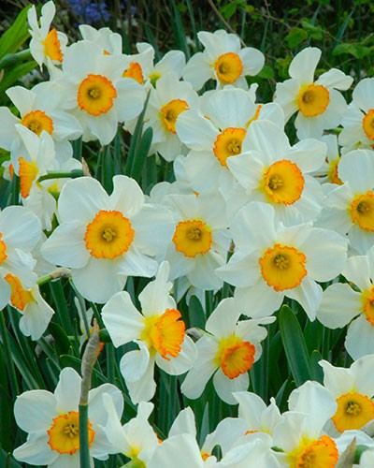
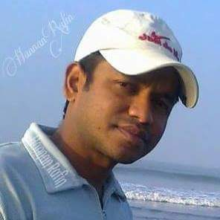
Welcome
To
Md. Abdul Hannan
Assistant Teacher(English)
Sonahata High School, Dhunat Bogra
Today’s Class
English 1st Paper
Class: Ten

Slide 2
Today’s Lesson : 3 The Return of the Native
After the end of the lesson we will be able to
»» know the theme of the article
»»learn the word meanings
»»talk about Michael Madhusudan Dutt, Root love
and its benefits
»»»
Unit: Twelve

Slide 3
It is a biographical article on Michael Madhusudan Dutt and based on the theme of roots love and its benefits.
The theme of the text

Slide 4

Word Meaning
Manner AvPvib/ixwZbxwZ , Genre, Mode,Convention,Attitude
Sophisticated Aristocratic , Honored , Blue blood
Adopt Take, Accept, Receive
Recognize Identify, Confess, Perceive, Appreciate
Precious Superb, Excellent, Pretty, Intelligent, Spanking

Slide 5
Today’s conversation on the topic of Michael, his roots love and benefits
»Suppose Afif and Rean , Students of class ten are two friends. Recently Afif has read the article on Michael Madhusudan Dutt . Rean wants to know it and Afif also wants to share it with him . Now Read the conversation .
Rean : Hello, Afif ! How are you?
Afif : Hi! I’m find and you?
Rean : I’m also fine .Thanks. What do you read today?
Afif : O ! Nice question , Today I read an article on Michael Madhusudan Dutt. Do you read it ?
Rean : Not really . But I heard about him something. Had he changed his name and religion ?
Afif : Yes . Do you know what the reason was ?
Rean : No. Please tell me .
Afif : Actually , he aspired to be an Englishman in form and manner from his early age. He was also believing that he was born on the wrong side of the planet . For that reason, he adopted his first name Michael and Christianity , and went to Europe to get right appreciation.
Rean : What did he do there?
Afif : He started composing poetry and drama in English. But, failed to gain the right appreciation although they showed his high level of intellectual ability.
Rean : Then ?
Afif : Then he retuned the native and composed a sonnet in Bangla “Kopotaksha Nad” which erned him huge reputation .
Rean : It’s roots love and benefits .
Afif : Surely , at last he understood that his true identity lay in Bangla .
Rean : He wrote Bangla epic “Meghnad Badh Kabya”
Afif : Yes . If you want to know more , search his name in Google . Good bye .
Rean : Bye.

Slide 6
Work in pair .
1 Why did Michael go to Europe
2 For what was he famous ?

Slide 7
Home Work.
Search in Google and write more information about Michael Madhusudan Dutt. Such as date of birth , birth place , Parents, wife and children.

Slide 8
Thank You

